Slide 1



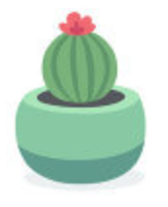

Let’s Build a Garden!
Notes:
Ask Questions:
Have you ever planted a plant before?
Note: Have an incentive to answer questions (e.g. candy and/or stickers)

Slide 2
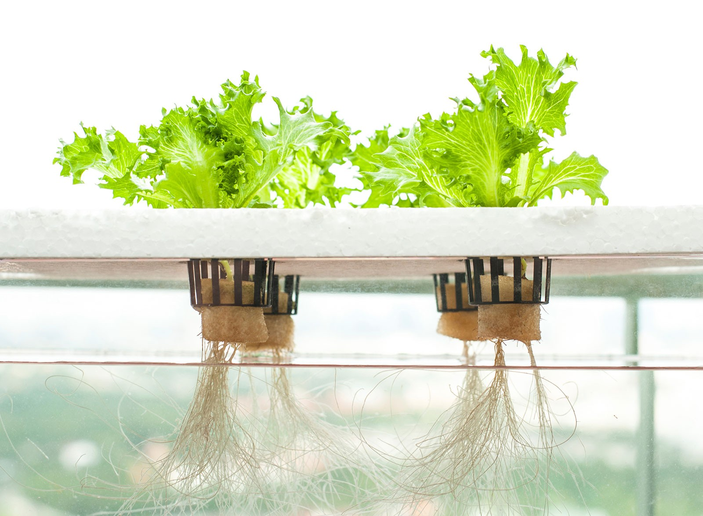
What is Hydroponics?
Gardening without soil
Water
Nutrients
Light
Oxygen

Slide 3
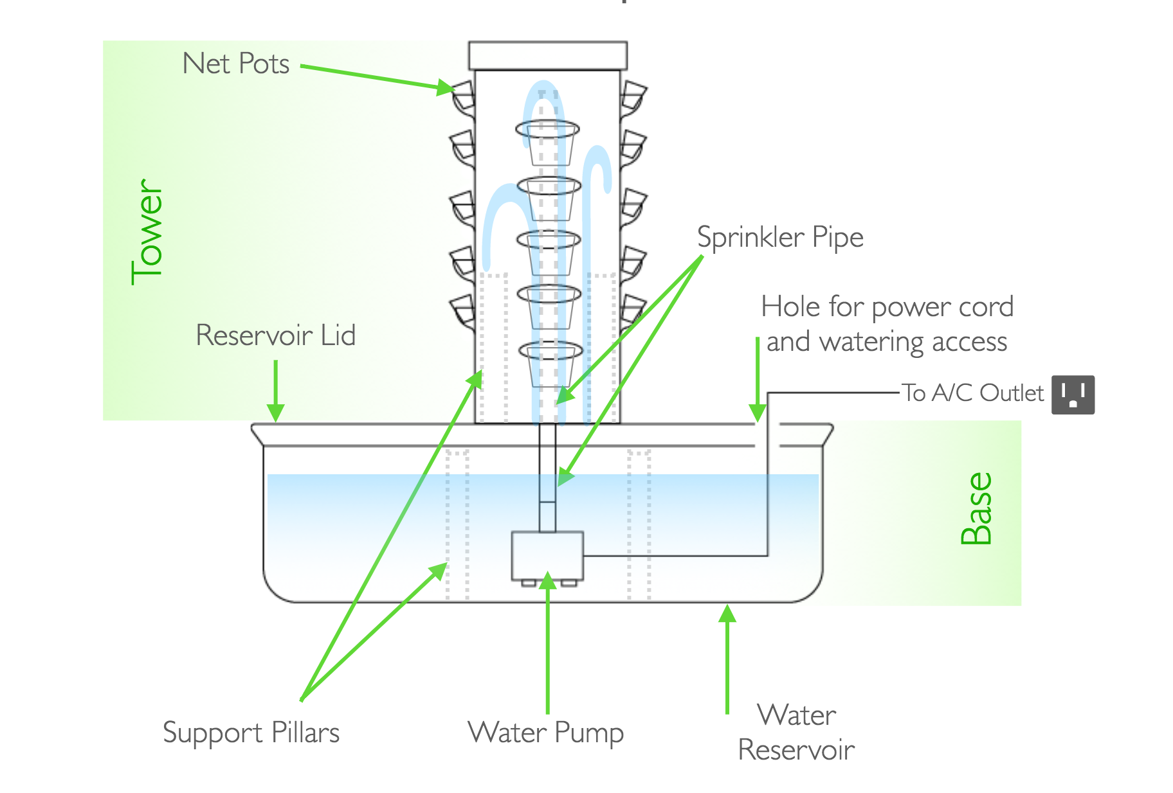
What’s in Our System?
Notes:
“Now we’re going to show your own class’s Hydroponics system”
Brings out system “unveils it”
Explains each part of the system
Container
Pump
Sprinkler
Tower
Plants/Pots
Water/Lights

Slide 4
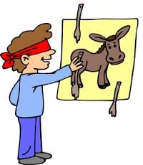
LET’S PLAY A GAME!
Notes:
Okay let’s play a game!
Who has played pin the tail on the donkey?
We are going to do something similar to this but relate it to our hydroponics system!

Slide 5
Work with your table group to connect your part to the description
Notes:
At your table, there is a shape of the hydroponics system. In 2 minutes, match each part to the description on the shape!

Slide 6
Our process is easy
plant
Water &
Fertilize
grow

Slide 7

Thank you!
Notes:
Thank you!! Any questions or comments?

